Slide 1
Global Warming UK GREENHOUSE GAS EMISSIONS 1990-2020
Project 1 – Group 4
Grace Cheuk (gw-sc)
Navindeep Bains (navinbains)
Salma Abdirahman (Salma-Abdirahman)
Farjana Rowther (fbrowther)

Slide 2
Agenda
01. Introduction
2. Who?
What we’re looking at and why we chose it
Which Sector produces the most emissions?
Which End User is responsible for most emissions?
03. What?
04. How?
05. Closing
Which fuel used contributes to the most emissions?
How much of our activities has changed over the course of time ?
Final conclusions and analysis.

Slide 3

INTRODUCTION
Greenhouse gases (GHGs) warm the Earth by absorbing energy and slowing the rate at which the energy dissipates to space; thus insulating the Earth

Slide 4
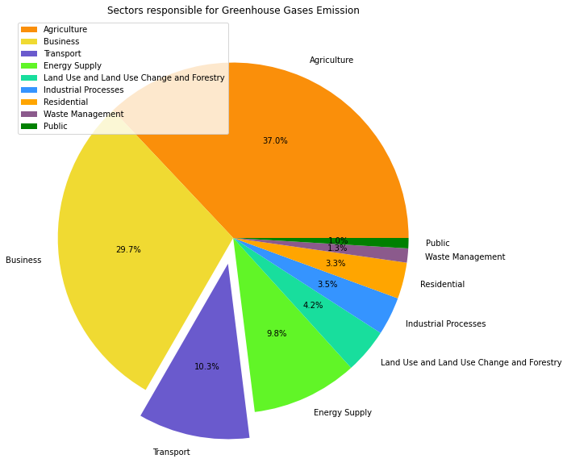
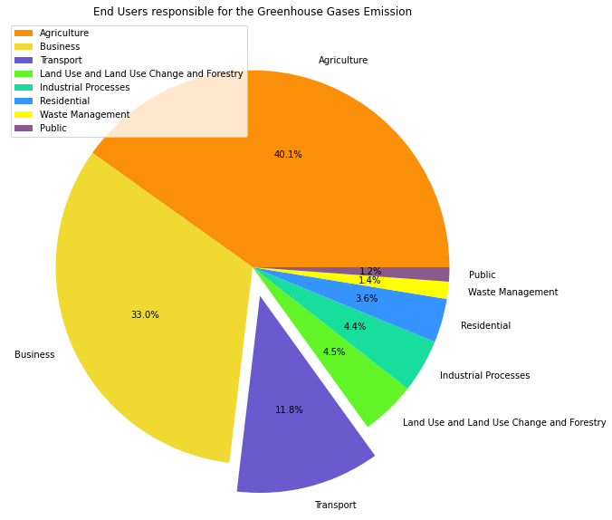
WHO?
WHICH SECTOR EMITS MOST
WHICH END USERS EMITS MOST

Slide 5
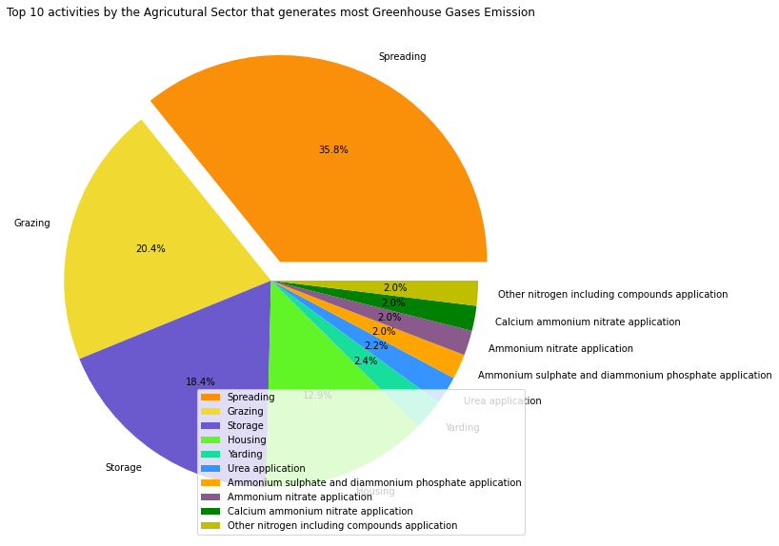
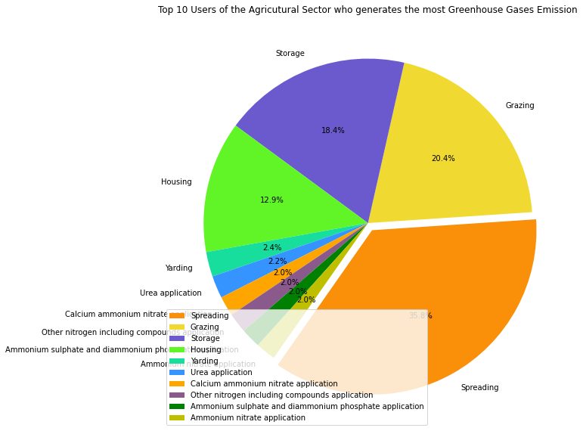
1st Contributor – Agriculture Sector
SOURCE
END-USERS

Slide 6
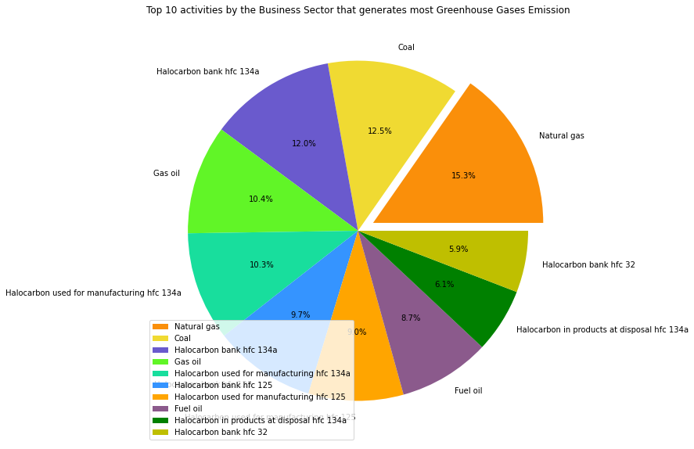

2nd Contributor - Business Sector
SOURCE
END-USERS

Slide 7
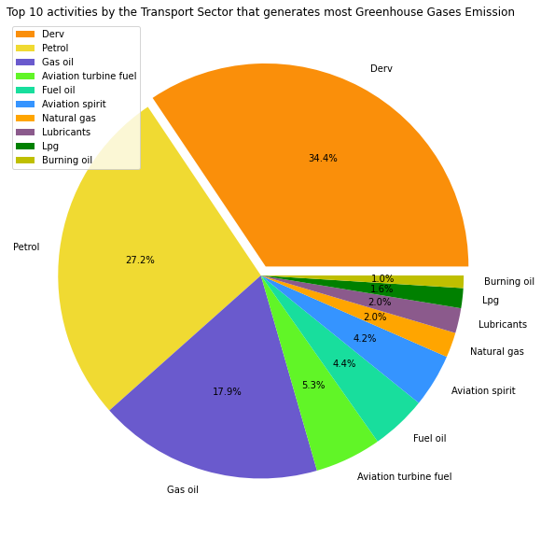
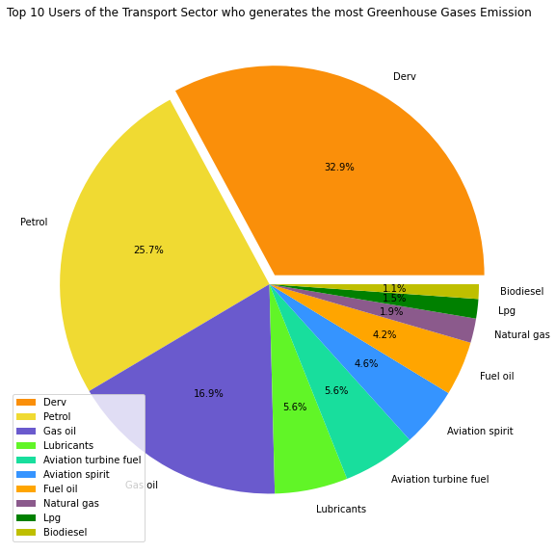
3rd Contributor - Transport Sector
SOURCE
END-USERS

Slide 8
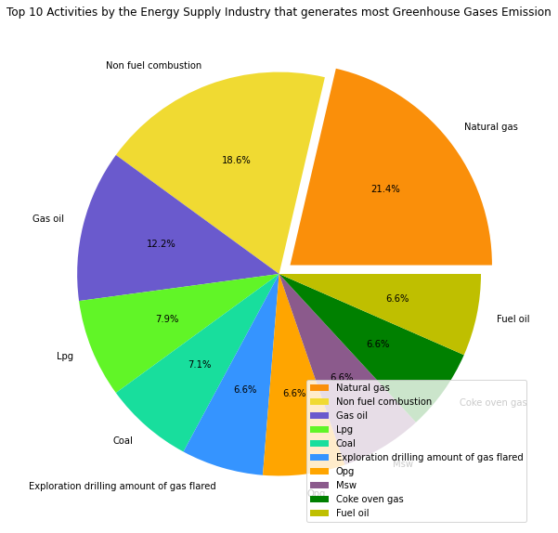
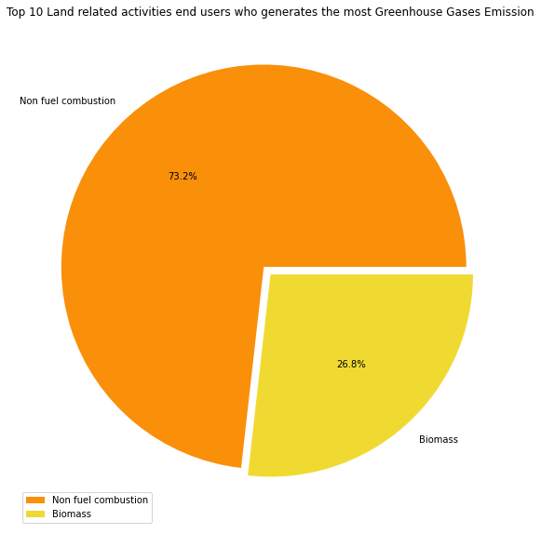
4th Contributor – Energy/Land-related Sector
SOURCE - ENERGY
END-USERS - LAND-Related
Drainage of organic soils (releases CO₂ and NO₂ into the atmosphere)
Farming (Cropland)
Wetland - Plants growing in wetlands emit methane to the atmosphere.
Biomass Burning (Forest fires)

Slide 9
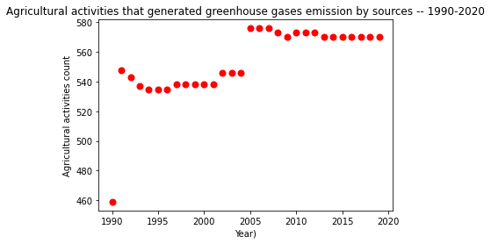
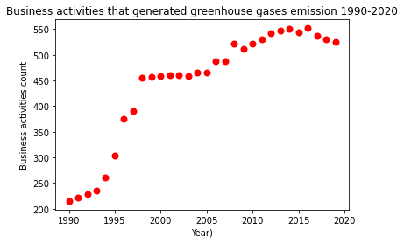
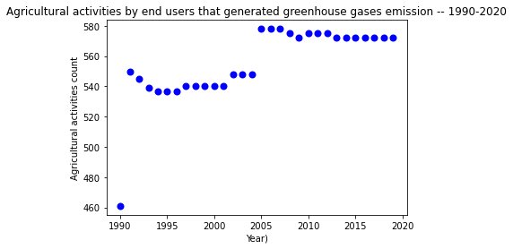
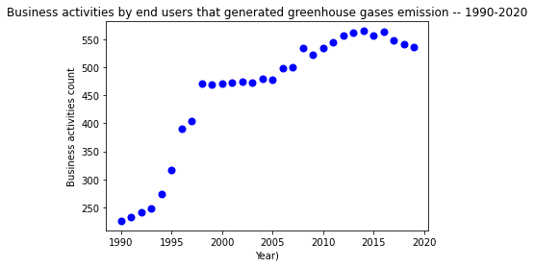
Contributor’s Trend- Agriculture & Business sector
SOURCE v/s END-USERS TREND 1990 -2020
Notes:
In order to identify whether there has been any changes to the activities of the top contributors I have grouped the entire dataset based on industry and looked at the trend in their activities for the whole duration of the dataset. Here you could see there has been a continual upwards trend contributing consistently to the greenhouse gases emission

Slide 10
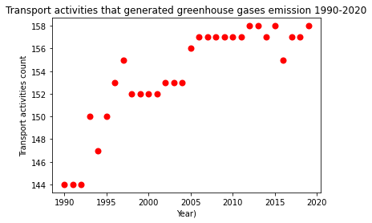
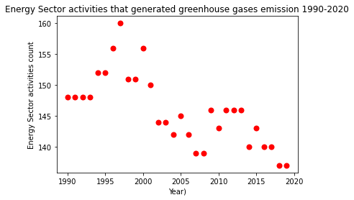
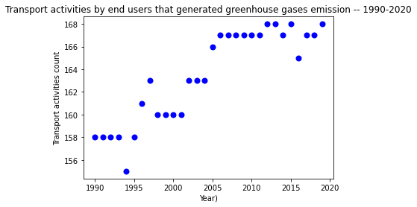
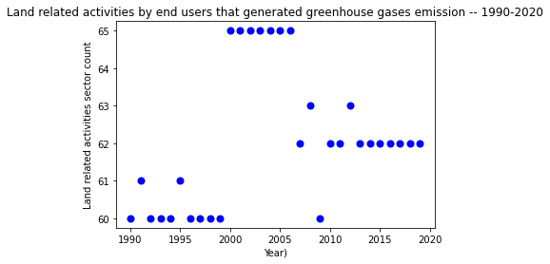
Contributor’s Trend- Transport & Energy/Land sector
SOURCE v/s END-USERS TREND 1990 -2020
Notes:
This trend continued on for the transport sector too. However, in case of the energy sector there has been slow but definite downward trend. With UK governments plan to phase out of UK's coal plants within nest few years should see further decrease in this sector with regards to emissions.
consistently to the greenhouse gases emission

Slide 11
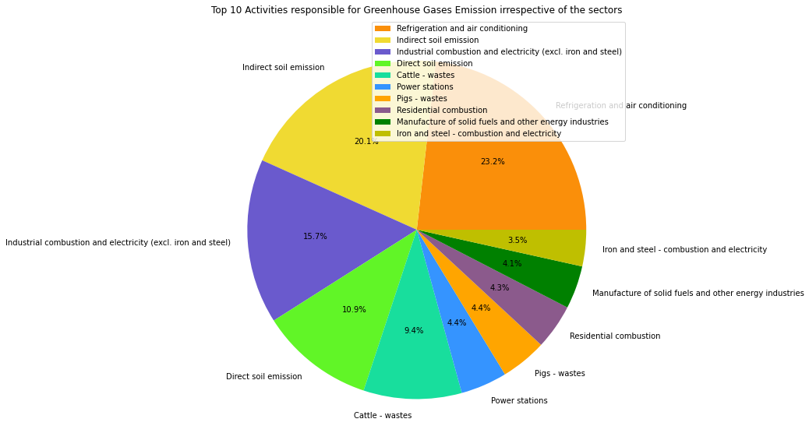
Top 10 contributors irrespective of sector
BY BOTH SOURCES & END-USERS
Notes:
In order to summarize what we have presented so far, in this fig we looked trend we can see with regards to contributor across the board irrespective of the sectors. Here we can see it is industrial combustion, agricultural soil management, refrigeration and air conditioning activities that contributes to more than 80% of the emission.

Slide 12
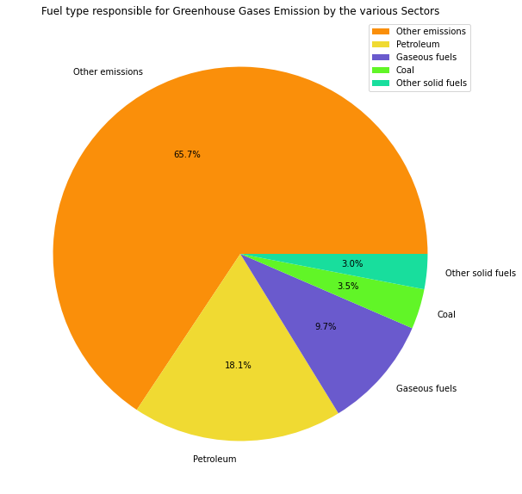
Fuel-Type
SOURCE & END-USERS
Other Emissions include –
Cattle, Horses, Pig and Poultry wastes
Soil emission (both direct and indirect),
Drainage of organic soils - settlements
Waste incineration,
Refrigeration and air conditioning,
Glass Production,
Gas flare,
Chemical Industries,
Power stations,
Industrial combustion,
Manufacture of solid fuels and other energy industries.
Notes:
from the point of view of sources and end-users, we saw a similar trend in the data for fuel type and greenhouse gas emission. Burning of the actual fuel contributed to 1/3 of the emission while the remaining 2/3 of the emission was contributed by four categories as seen in the previous slide – industries, industrial combustion, agricultural soil management, refrigeration and air conditioning activities that contributes to more than 80% of the emission.

Slide 13
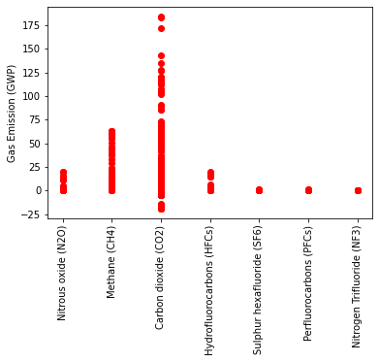
Composition of Greenhouse Gases
BY BOTH SOURCE & END-USERS
1. Carbon dioxide (CO₂)–
CO₂ causes 80% of global warming and its release is mainly contributed by fossil fuels burning like coal, oil and gas or deforestation.
2. Methane (CH₄)–
Methane possess >80 times the warming power of carbon dioxide for the first 20 years after being released
3. Nitrous oxide (NO₂) –
Increased N- based fertilizer use (>50 years) has been responsible for dramatic increase in its emission.
4. Hydrofluorocarbons (HFC) –
HFCs are highly effective at trapping solar radiation (infrared radiation) and redirecting it toward Earth's surface.
Major source of HFCs are refrigeration and air conditioning
Notes:
Greenhouse gases in our dataset agreed with and showed a similar composition of gases to the total emission as noted before in published US environmental protection agencies data. This included CO2 being on the top, followed by Methane, Nitrous oxide and Hydrofluorocarbons.

Slide 14
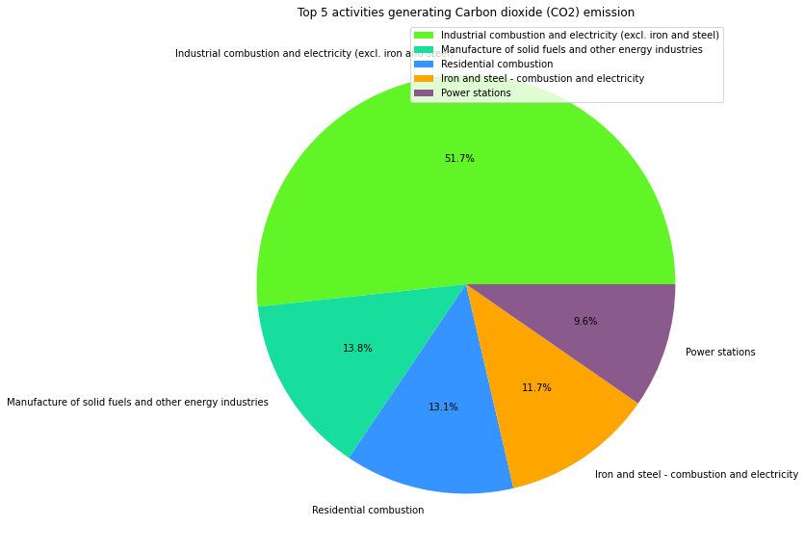
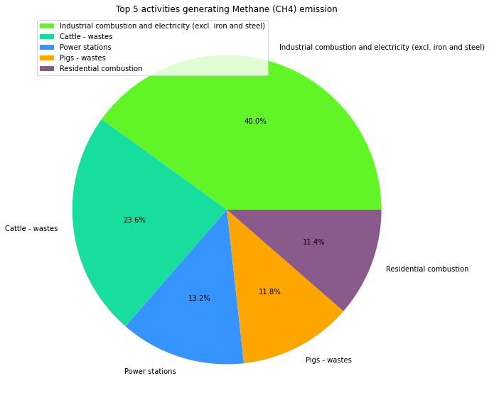
Top Emitters of -
CO₂
Methane
Notes:
top emitters of CO2 include industrial combustion, solid fuel insustries and power stations.
In case of Methane the major emitters are combustion and animal wastes.

Slide 15
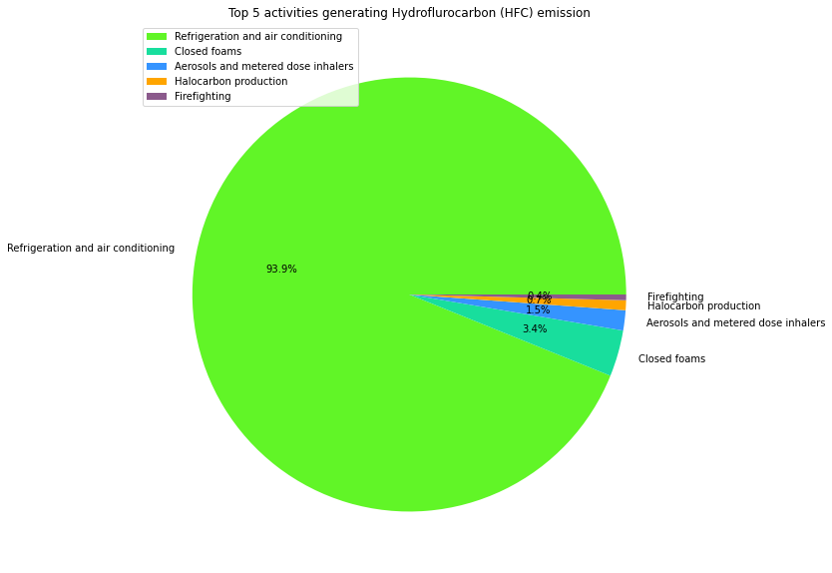
Top Emitters of -
NO₂
Hydrofluorocarbons
Notes:
The top emitters for Nitrous oxide include combustion, power plants and animal wastes
While the sole emitter of hydroflurocarbons included refrigeration and air conditioning

Slide 16

SUMMARY
WHO – MAJOR SECTORS RESPONSIBLE
TOP ACTIVITIES
Refrigeration and air conditioning,
Soil emission (direct and indirect),
Industrial combustion,
Animal wastes,
Power stations,
Residential combustion,
Manufacture of solid fuels and other energy industries.
Agriculture,
Business,
Transport,
Energy
Land-related activities
TREND
CONCLUSION
There still exists an upward trend in the activities of the major contributing sectors for GG emission
The policy makers need to take stringent urgent measures that ensures current practices are rapidly transformed to slow the release of the emission
Alternatively, we should also look into modalities to capture and transform already released gases to limit its damages.

Slide 17

Thank you
Group 4

